Slide 1
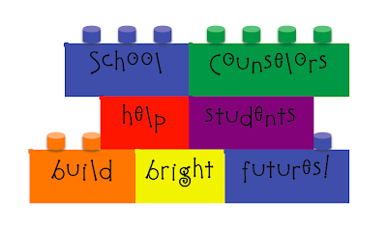
School Counseling Program
Presented by: Teresa Barksdale
September 2020

Slide 2
A school counseling program reaches EVERY student and focuses on the knowledge, skills, and attitudes needed for an individual's successful academic achievement, career development, and personal & social growth.

Slide 3
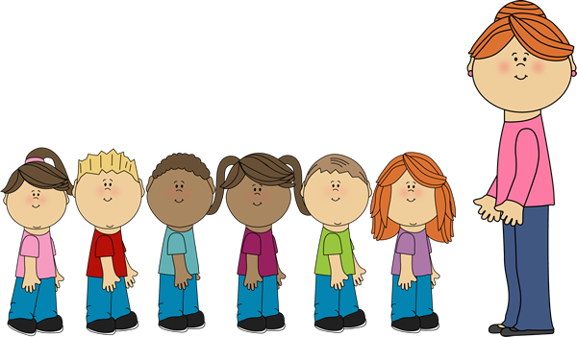
A counselor's time is spent maximizing the benefits of a program that serves ALL students.
As of today we have:
3rd grade 236
4th grade 245
Williams Avenue has a total of 481 students.
Of these students we have 95 that are
virtual learners.

Slide 4
Williams Avenue Elementary Guidance Program
is to prepare every student socially, academically, and emotionally for whatever challenges he/she may face.
We want to help guide and support learners in their life-long journey of developing
their very best self.

Slide 5
Guidance Program
Large Group Session
(1 time a month for each class)
Second Step Program
Directly teaching students the skills that strengthen their ability :
Skills for Learning: Students gain skills to help themselves learn, including how to focus their attention, listen carefully, use self-talk to stay on task, and be assertive when asking for help with schoolwork.
Empathy: Students learn to identify and understand their own and others’ feelings. Students also learn how to take another’s perspective and how to show compassion.
Emotion Management: Students learn specific skills for calming down when experiencing strong feelings, such as anxiety or anger.
Problem Solving: Students learn a process for solving problems with others in a positive way.

Slide 6
Continue: large group presentations
Erin’s Law review with students (Power point on abuse)
Physical abuse
Neglect
Emotional abuse
Sexual abuse
Jason Foundation
dealing with suicide is address in a small way. This is a subject that is very sensitivity. Working with 8 and 9-year-old students I talked to them during Erin’s law presentation and Drug Prevention presentation about being good to our ourselves and not hurting our self. We discuss what to do if we feel sad or confused and when to ask for help when it is needed.

Slide 7
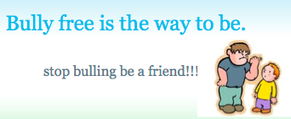
Bulling and Drug Awareness topics (October)
Red Ribbon Week October 26-30 (The national awareness days are October 23-31)
I address Bullying several times throughout the school year. (usually in October, November, and December)

Slide 8
Possible Large group Presentations (if we are permitted)
Local Authors
Local Dentist
Resource Officer presentation

Slide 9
Small Group Sessions: as needed
Making and keeping friends – Reflecting on the characteristics of good friends.
Self Esteem – Small group sessions to boost student’s confidence.
Anxiety – Providing student with the tools they need to overcome their anxious feelings.
Being Respectful – small group sessions learning what respect looks like in the classroom and other places throughout school.
Anger management – small group sessions to help students learn how to identify and appropriately express their anger.
Behavior – small group or individual sessions to help students with overall behavior.

Slide 10
Individual Groups as needed
Activities includes but not limited to:
Grief
Worries
Calming techniques
Family
Managing Anger
Feelings
Coping skills
Behavior

Slide 11
Questions
If you have any questions please let me know.

